Slide 1
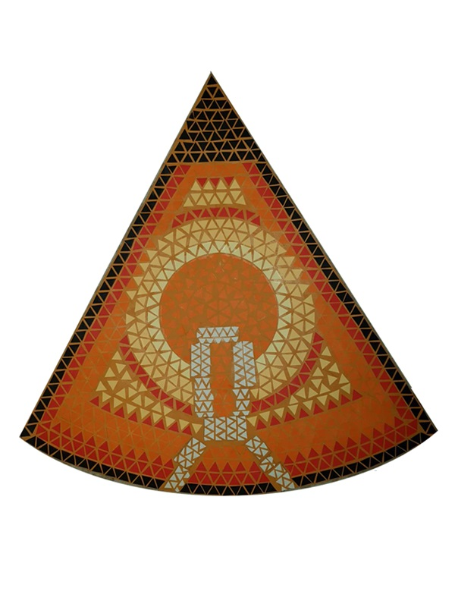
Mosaic Lepenski vir
Project
Elementary school „Vuk karadžić“, belgrade
Project authors:
Nikola Šaranović, 7th grade Sofija Stojanović, 7th grade Anja Radošević, 8th grade Nadja Radošević, 8th grade Tara Takić, 8th grade Lena Vračević, 8th grade
Students of the class: V-3, VI-3, VI-4, VII-3, VII- 4, VIII-3, VIII-4
Project mentors:
Biljana kojić
Marina Lakčević
Model in paper version, work by Tara Takić

Slide 2
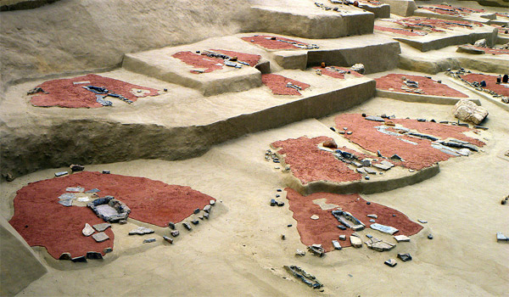
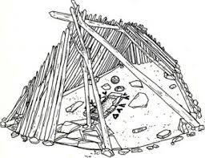
Lepenski vir
Idea
Equilateral triangle and compass
We got the idea for the project on the topic of Mosaic after visiting the historical site Lepenski vir, on an excursion, in October last year;
We chose the equilateral triangle to be a segment of the mosaic because Brian J: Mc Cartin stated in his work MYSTERIES OF THE EQUILATERAL TRIANGLE that the oldest equilateral triangle was discovered in the Mesolithic Neolithic settlement of Lepenski vir (6000 BC). We have connected in a time mosaic life then and now.
We decided to make a hut in the same way as Lepenci, but with a modern lighted floor base. We imagined that the floor mosaic would be illuminated by LEDs.
Lepenci did not have mathematical knowledge, but they intuitively determined perfect measurements. The scale of the dimensions of the reconstructed archeological remains indicates an intuitive sense of perfect harmony - a golden section.

Slide 3
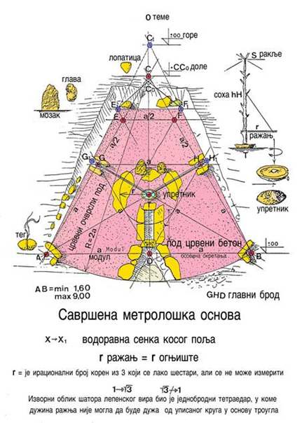
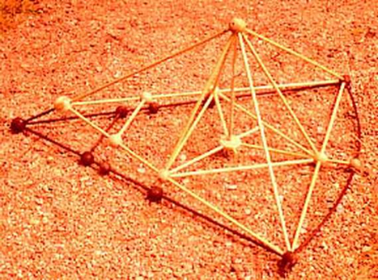
Lepenski vir-mathematical concepts
Research work
Setting up a hut
Our activities during the preparation for the construction of the hut are based on the research of Dr. Eng. Predrag Ristic, who received his doctorate in Graz on the topic of reconstruction and urbanism of Lepenski vir.
Model, work of an architect
Pedje Ristić
One of the assumptions is that the foundations of the huts of Lepenski vir, spanning up to 9 m, discovered on the sand along the banks of the Danube, were made in three strokes, by drawing- coding with a rope and a stake (using a stick and rope) in the sand.
By hexagoning, they determined a circular section with an angle of and radius r
At the center of gravity of the triangle on the side r, which is marked by a stone called a upretnik, they placed a soho tree with a branch that had the function of a skewer.
The length of the hearth could not be greater than the radius of the inscribed circle in the triangle.
Due to the slope of the bank towards the Danube, part of the floor of the hut had to be cut, so that the floor of the inner part of the hut was trapezoidal in shape.
Under our hut is a circular section with a radius of 60 cm.

Slide 4
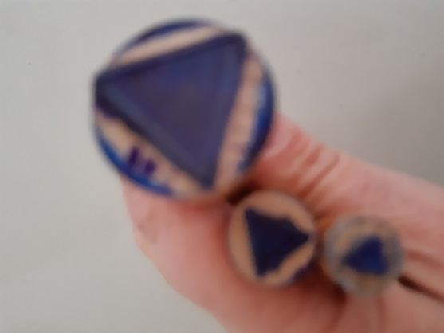
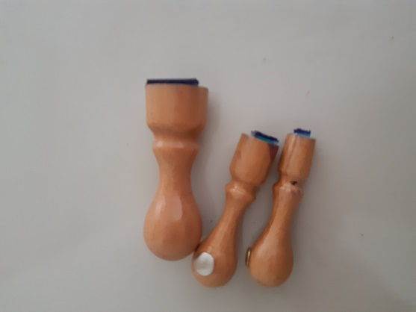
Lepenski vir-mathematical concepts
It is assumed that the hut was in the shape of a tetrahedron or a three-sided pyramid . The hut we made has the basis of the shape of an equilateral triangle with a side of 60 cm , and proportionally placed elements according to the measurements on the artifacts from the Lepenski vir museum. The height of the base is 30 cm long , the radius of the inscribed circle (length of the hearth) is 10 cm , the stone is placed in the center of gravity of the triangle which represents the base of the tetrahedron. The height of the hut is equal to the radius of the described circle around the triangle 20 cm , so that the side edges have a length of 20 cm. The scale of our hut and one of the huts of the settlement is 1:15.
The builders of the Lepenski vir hut did not know about the lengths whose measured numbers were irrational, but they intuitively estimated the perfect measurements.
The middle line of the triangle divides the radius belonging to the axis of symmetry in the ratio 3: 5.
The mosaic segments in the paper variant are equilateral triangles and on the model the LEDs are in 3 colors. The entire work on the project is in the sign of an equilateral triangle, so we made stamps with the imprint of an equilateral triangle in three sizes (pages 1 cm, 1.5 cm and 2 cm).

Slide 5
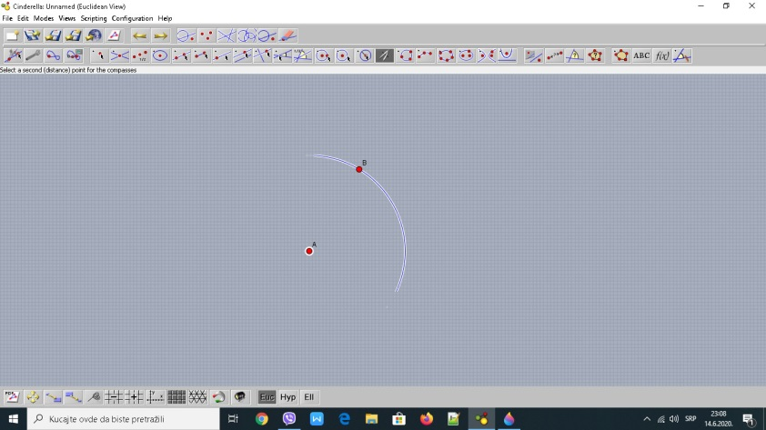
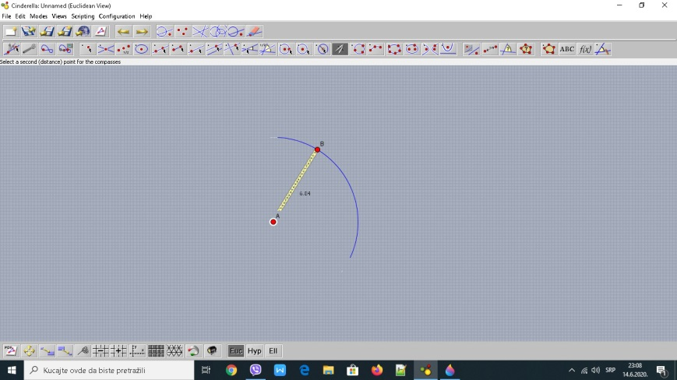
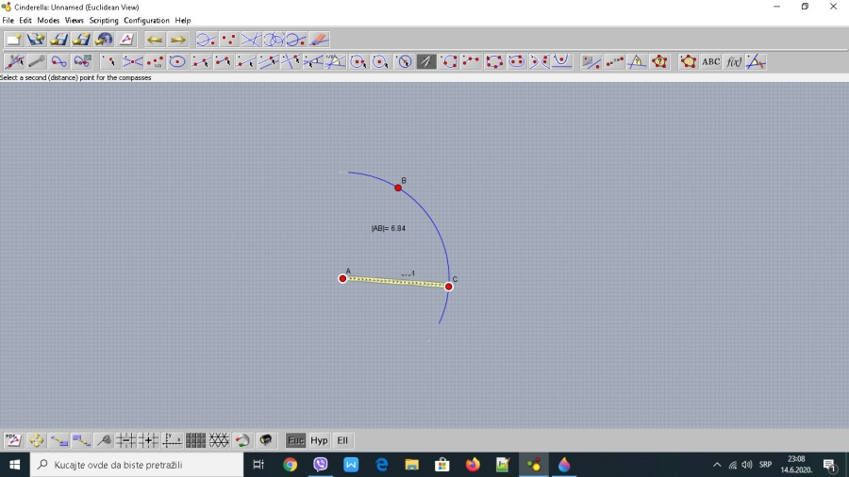
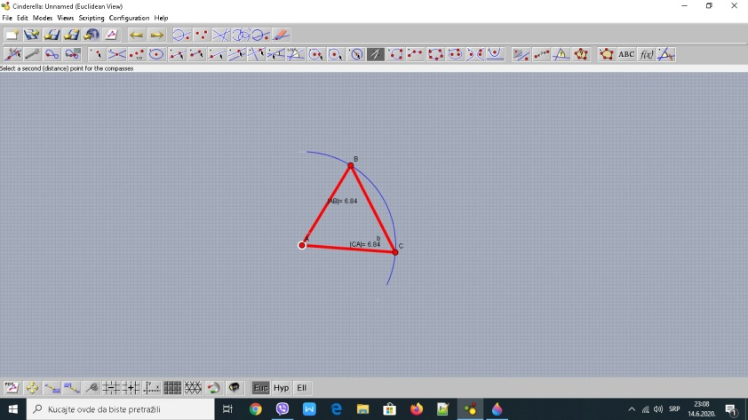
Informatics-software tools
Cinderella-construction by compass

Slide 6
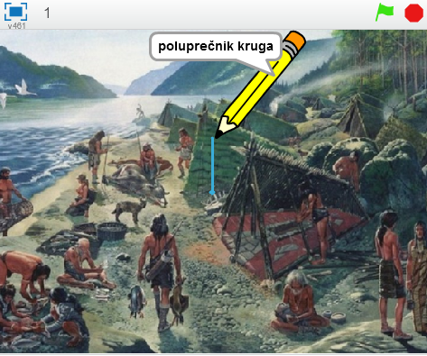
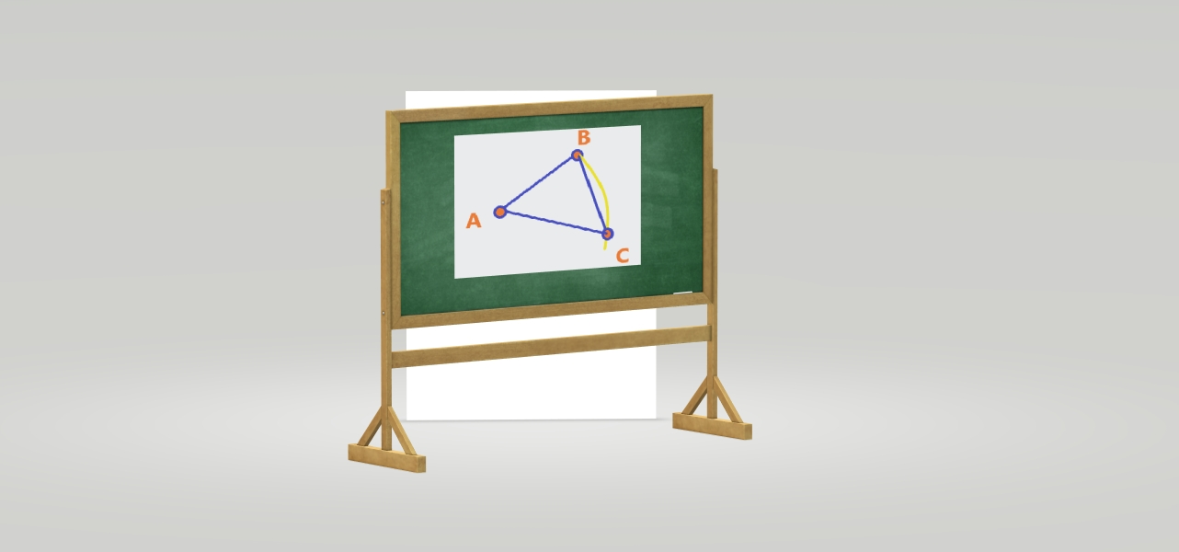
Informatics-software tools
Scratch
Paint-3D

Slide 7
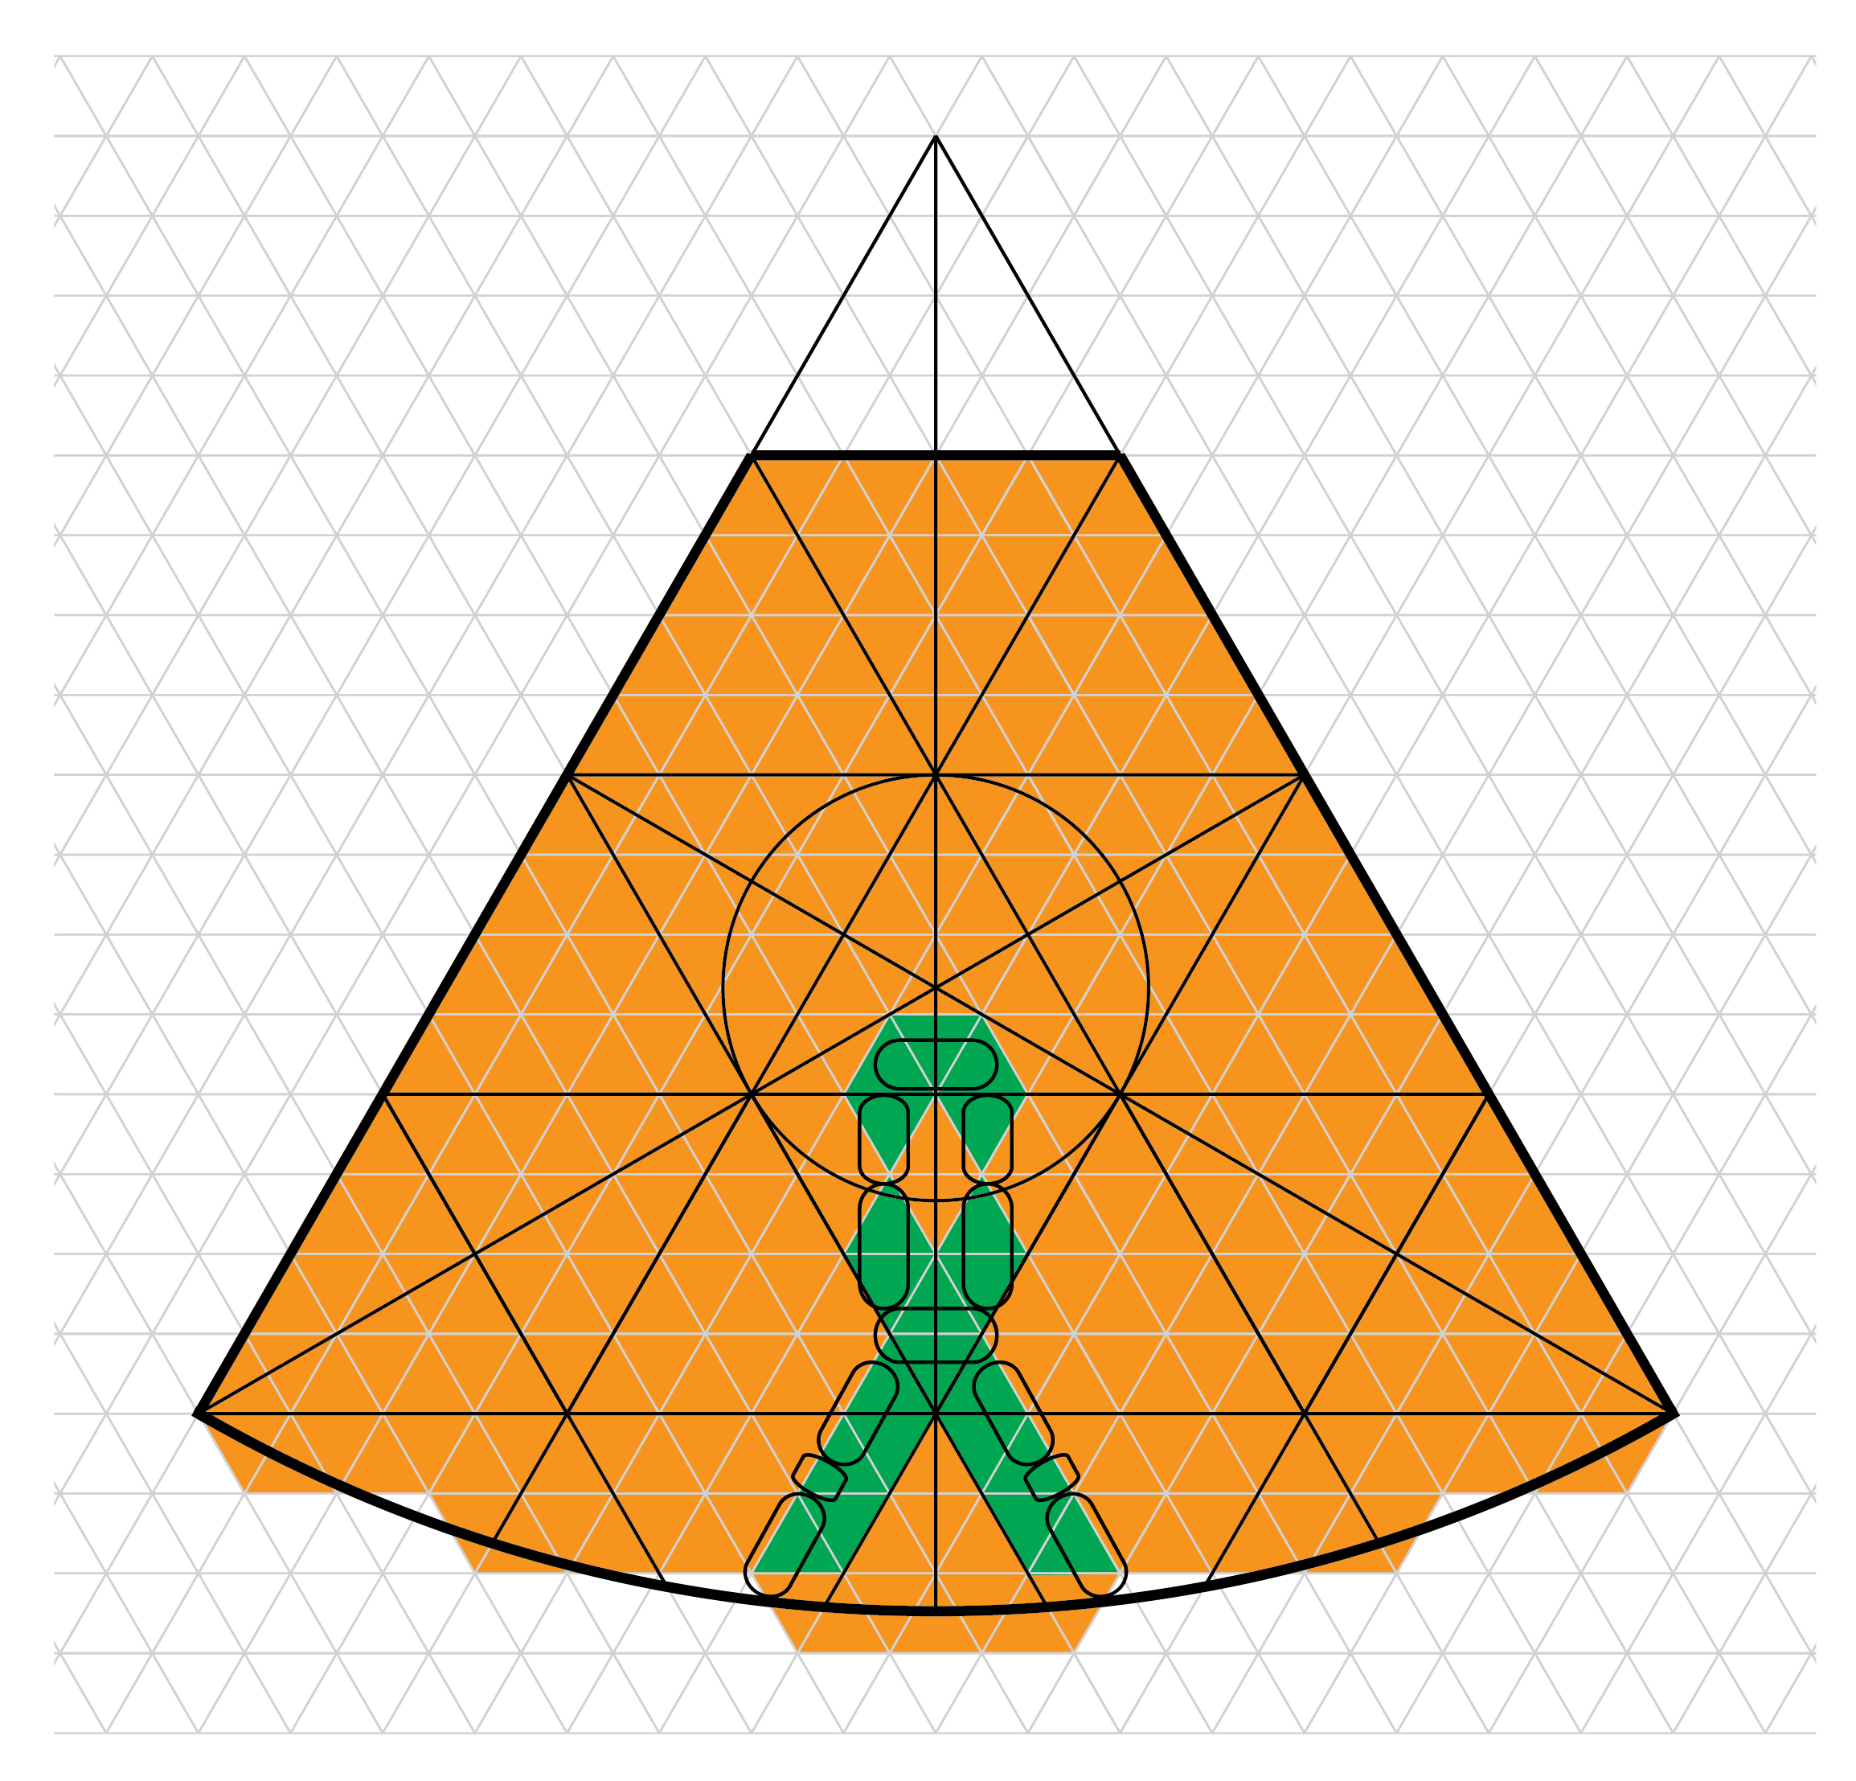
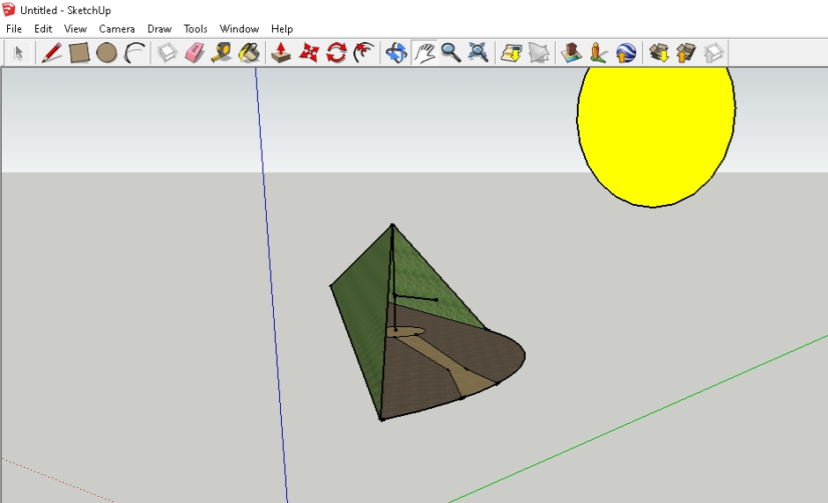
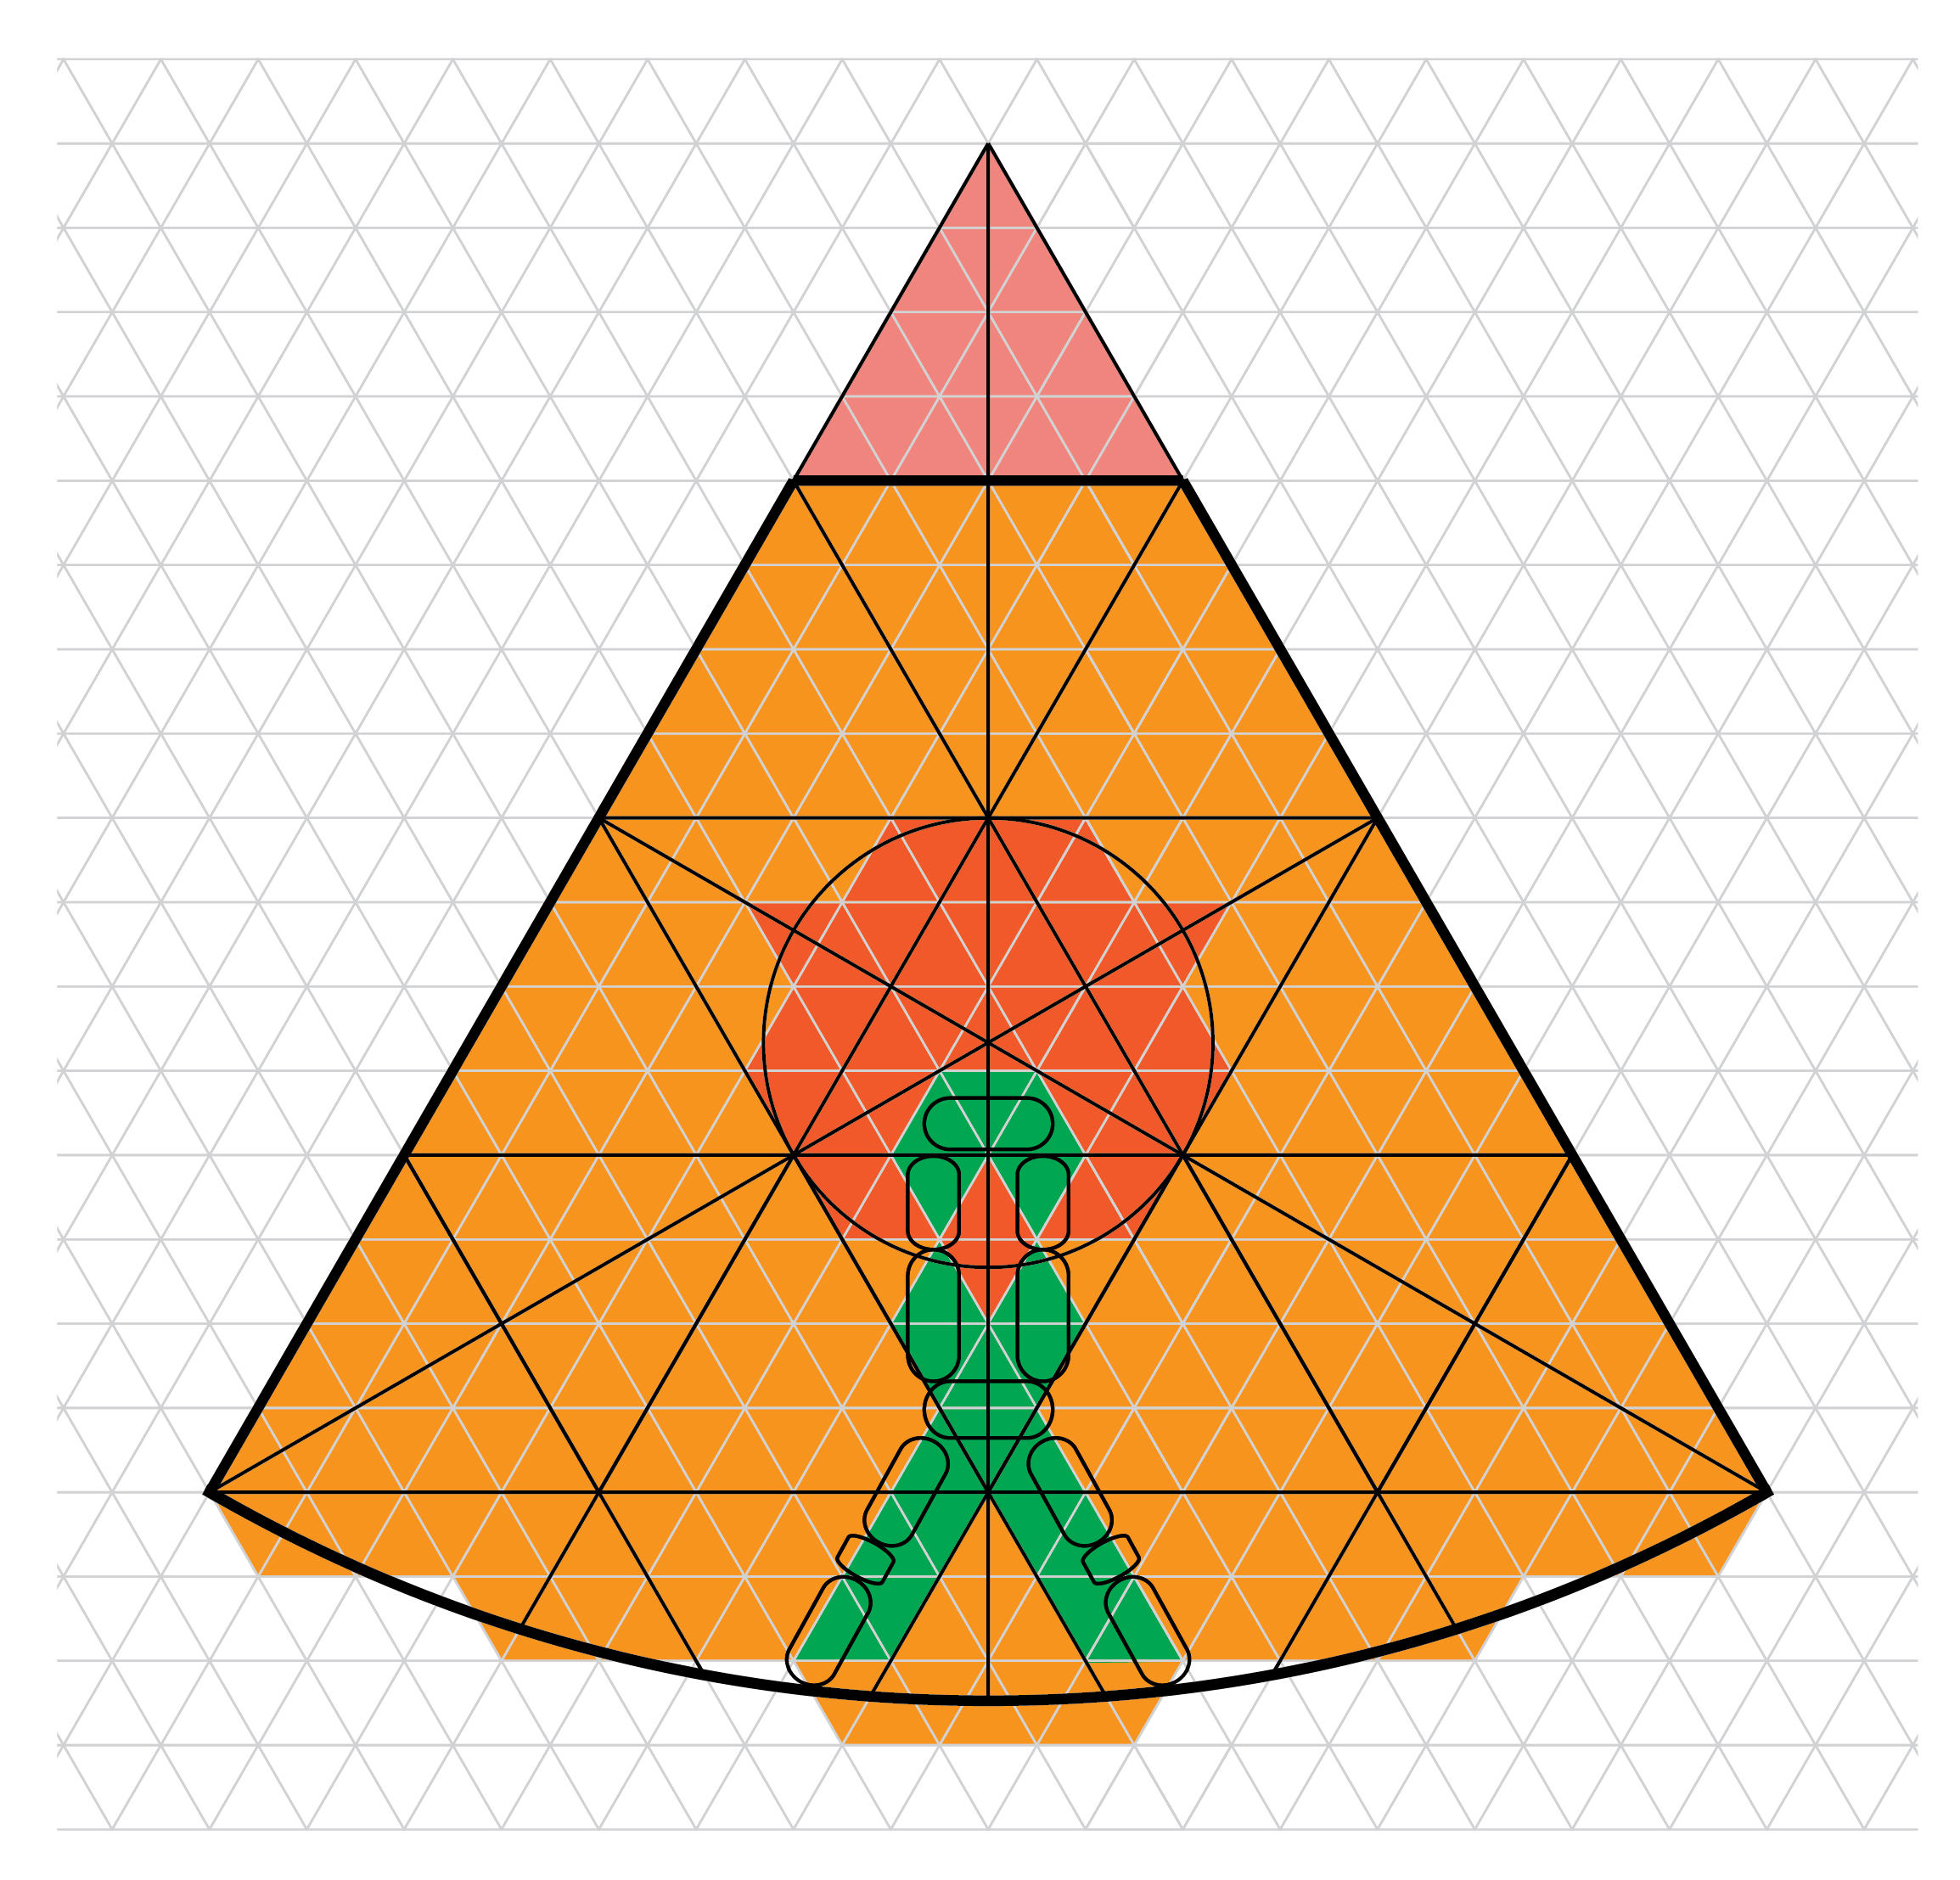
Lepenski vir - Informatics
Illustrator
Sketh-Up

Slide 8
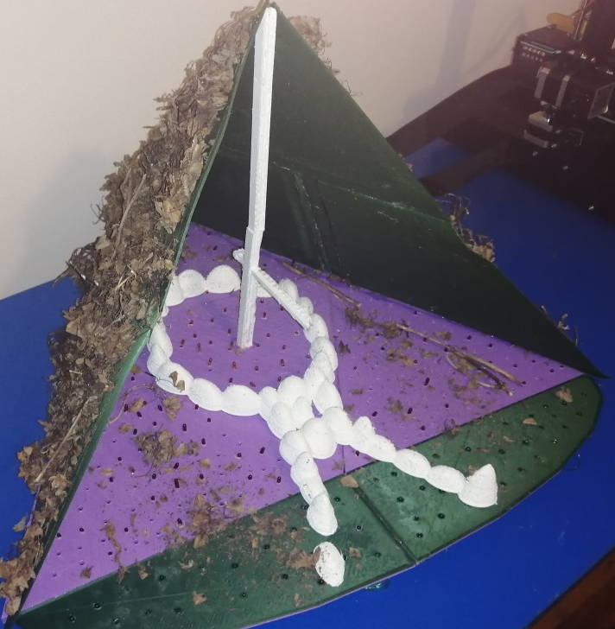
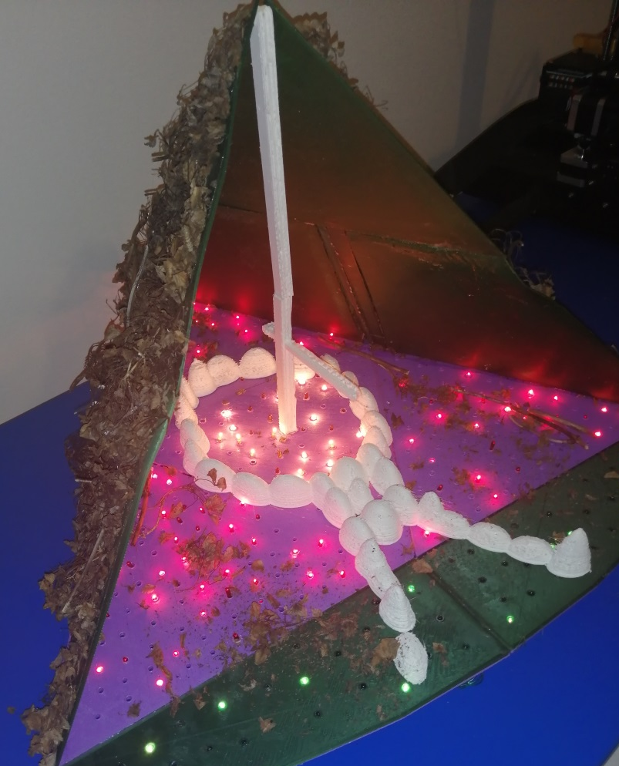
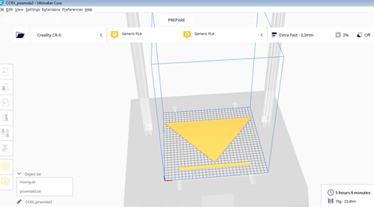
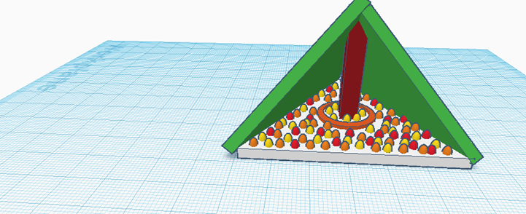
Lepenski vir - Informatics Tehnique and Tehnology
Preparing for 3D printing
Printed model
The program in which the model was made is Tinkecard
Preparation for 3D printing is done in Ultimate Cura
Print a model on the printer Creality X 3D printer

Slide 9
Lepenski vir- Tehnique and Tehnology
Models
The modern name Lepenski vir originated in the Serbian language from the word "lep", which means mud with which the umbrella is covered, with mud, mixed with chaff, which was deposited in the estuary of the whirlpool. Lepenski vir is therefore a whirlpool in which there is beauty.
Due to the current situation, the students were given the task to make vessels, bowls, vases that would resemble the Lepenski vir, and at the same time use a mosaic in their model making, using different geometric shapes.

Slide 10
Lepenski vir-historical data
During the work on the project, we learned that Lepenci overcame all adversity by working together and we recognized the necessity of teamwork in our team.
The oldest discovered organized human settlement
Lepenski vir is a significant archeological site on the bank of the Danube in the Đerdap gorge (discovered in 1965). The culture of Lepenski vir began to develop around 7000 BC, so that the place itself was intensively inhabited in the period from 6300 to 5500 BC. On the life of the inhabitants of Lepenski vir, based on material historical sources, the famous archaeologist Dragoslav Srejović noted: "Everyday life of the inhabitants was extremely difficult ... The strength and skills of an individual were not enough for such a fight. It took a joint effort to find the spoils . "

Slide 11
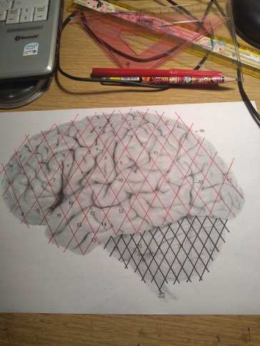
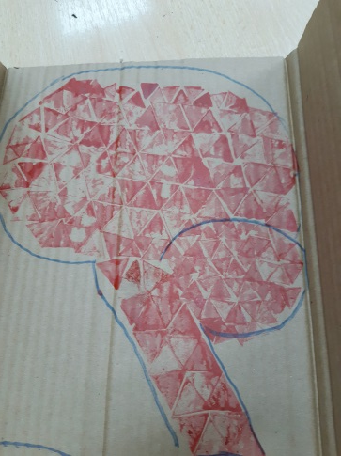
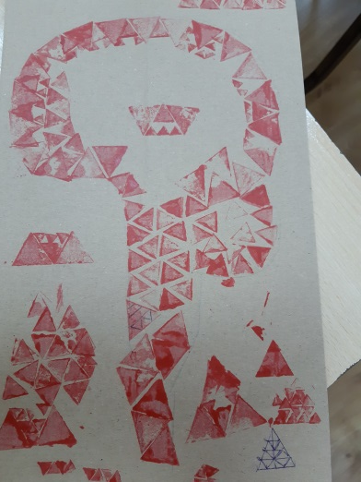
Lepenski vir-biology
Way of feeding
Brain and Mosaic
By researching the population and way of life in the oldest organized human settlement, we learned:
The population that then inhabited these areas was surrounded by a rich selection of terrestrial and aquatic organisms. There were still no clay pots for preparing food, but the food was thermally processed by roasting on a spit (in the center of gravity of the floor base, a stone was placed, there was a soho tree with a sledgehammer on which the caught animal was baked).
The habitat was rich in large animals: deer, wild boar, bear, and the Danube was rich in fish: carp, catfish and especially important cod.
Our famous mathematician Mihajlo Petrović Alas researched the fish of the Danube.
Based on genetic research of halpogroups ( halpogroup is a part of the population that has a common ancestral line and based on that the movement of people through space and time along the male line is monitored), it contains a halpogroup of Neolithic people from Europe east.

Slide 12
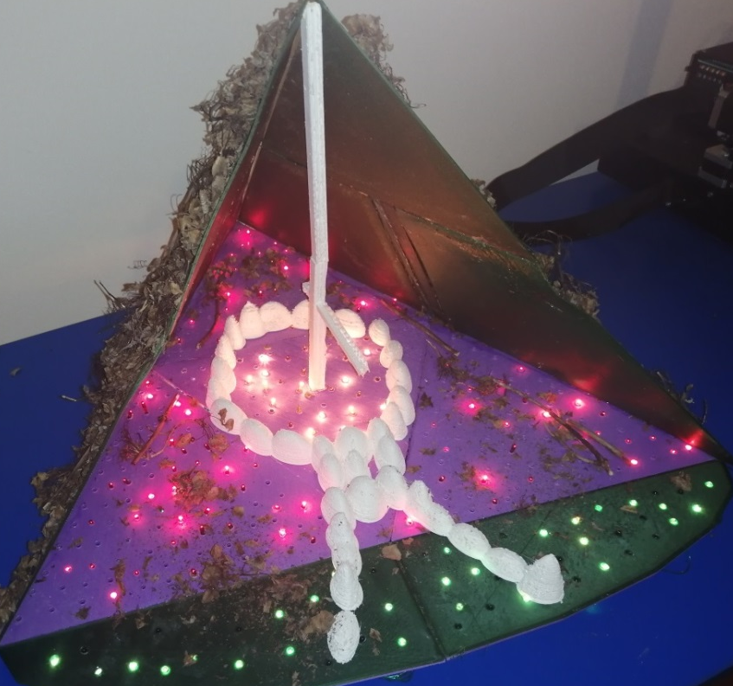
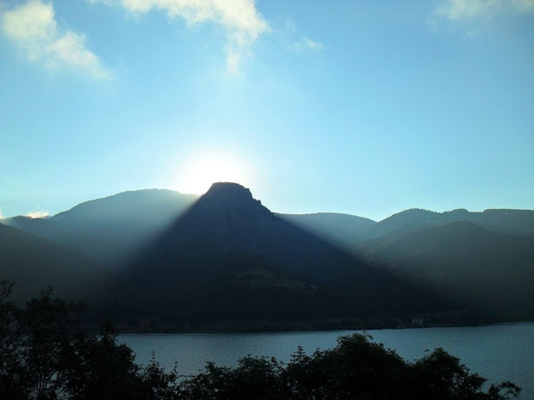
Time mosaic or what has changed in about 6000-8000 years
The lighting has changed
Our hut is lit by LEDs
Treskavac Hill, across from Lepenski vir, a sanctuary older than Delphi, in the shape of a regular trapezoid, served as an astronomical landmark. Each entrance to the hut faces this hill, so that the sun's rays illuminate the hut. On the summer equinox, on June 21, at sunrise, the whole hut would be lit.
The archeological site was discovered during the preparations for the construction of the Djerdap hydroelectric power plant.

Slide 13
Time mosaic or what has changed in about 6000-8000 years
A lot has not changed
A lot needs to be change
All research shows that physiologically and psychologically, Lepenci did not differ from today's people.
Perfect proportions have been retained in the basis of every perfect architectural work.
The skewer is still tempting.
The people of that time had an awareness of the world as a common home, which enabled them to come to terms with nature, intuitively feel order and thus approach the organization of life.
Today, nature too often warns man that he is not the center of the world and that he should live in harmony with his surroundings.
There are no more cod in the Danube.

Slide 14
Project reflection
We learned
Mosaic
Mosaic is an extremely important and old technique with meaning and tradition. Many philosophers and artists compare it to society itself and human communities. Each of us is different and unique as a cube (diode or triangle) of a mosaic, but just as unequal and diverse they make a unique work. So we, as individuals, should strive to build a harmonious whole together, despite the differences. Team members, students in the class, in order to be successful, must together create a harmonious whole, like a mosaic that creates a work of art from a lot of imperfect parts.
Working together on the project enabled us to:
- different approach and understanding of the material, we understood interdisciplinarity;
- strengthened our mutual communication:
-strengthened respect for individual initiatives and overcoming challenges in opposing opinions and ideas:
-we learned to make a strategy of research and problem solving:
- we have learned to choose the most important from the multitude of information and offered material and to complete the planned whole.

Slide 15
References
Sources of information
http://blog.b92.net/text/2332/Umetnost-mozaika/
https://sr.wikipedia.org/sr-ec/%D0%9C%D0%BE%D0%B7%D0%B0%D0%B8%D0%BA
http://www.rts.rs/page/stories/sr/story/16/kultura/2411676/mozaik-u-crkvi-svetog-djordja---raskos-u-15000-nijansi-boja.html
https://mozaikmamako.wordpress.com/2011/11/23/mozaik-tehnika/
https://www.juznevesti.com/Kultura/Mozaici-stari-1700-godina-najzad-pred-ocima-javnosti.sr.html
https://www.teachervision.com/mosaics
https://www.opsteobrazovanje.in.rs/sta-znaci/mozaik/
http://otacmilic.com/kako-je-tekla-izrada-i-odbrana-doktorata-o-lepenskom-viru/
http://www.svevlad.org.rs/povesnica/lepenski_vir/ristic_lepenski.html
http://www.svevlad.org.rs/povesnica/lepenski_vir/lv_sestarenje.htm
https://www.rasen.rs/2017/02/tajna-zlatnog-preseka-veza-izmedju-kulture-lepenskog-vira-vince-srednjovekovne-srpske-kulture/#.XkZ0zihKjIU
VUK, mosaic,
work of Tara Šćepanović

